Slide 1
TEAM 5
Volodymyr , Adam, Nacer, Juan Maria, Antonio

Slide 2
Index
Tactical Analysis
Winning Match Analysis
Losing Match Analysis
Draw Match Analysis
Comparative Defensive Metrics
Tactical Implications for Defensive Structure
Positional Heat Maps Comparison
Training Applications
Contextual Factors and Adaptability
Key Takeaways and Implementation Strategy

Slide 3
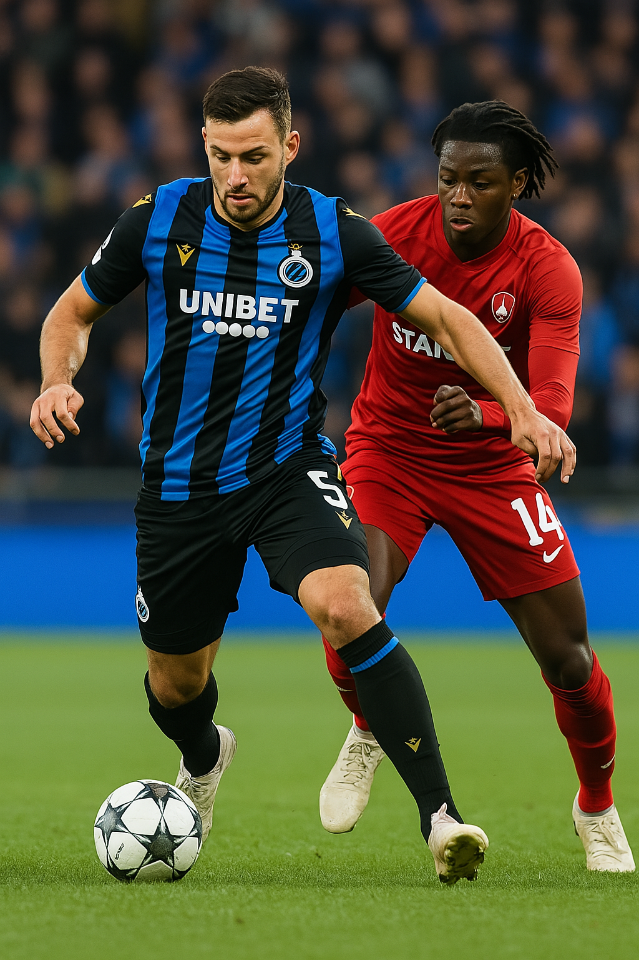
Tactical Analysis: Defensive Positioning and Match Outcomes
Objective: Analyze the relationship between defender positioning and match outcomes
Focus: B. Mechele’s performance across three result scenarios for Club Brugge
Key Elements:
Tactical discipline
Positioning
Movement patterns
Findings: Distinct defensive behaviors linked to wins, draws, and losses
Purpose: Provide insights for coaches and analysts
Content:
Examining specific defensive patterns
Tactical implications
Practical applications for defensive strategy and player instruction

Slide 4




Winning Match Analysis: Club Brugge vs Anderlecht
Right Flank Concentration
Highly concentrated defensive activity
on the right side of own half
Limited Central Movement
Minimal movement in central areas
and attacking third
Disciplined Positioning
Dead zones logically limited to
non-defensive areas

Slide 5








Losing Match Analysis: Club Brugge vs Gent
Dual Hotspots
Positional Instability
Two main activity concentrations: central position and own half
Frequent movement outside of designated defensive zone
Scattered Movement
Reactive Defending
Widespread activity across the pitch including opponent's half
Movement patterns suggest responding to threats rather than preventing them

Slide 6
Draw Match Analysis: Club Brugge vs Union SG
Balanced Distribution
Central Tendency
Moderate Flexibility
Movement pattern shows more even distribution across defensive zones compared to both win and loss scenarios
Slightly increased activity in central areas while maintaining reasonable flank coverage
Neither strictly zonal nor completely free-roaming, suggesting a hybrid defensive approach

Slide 7
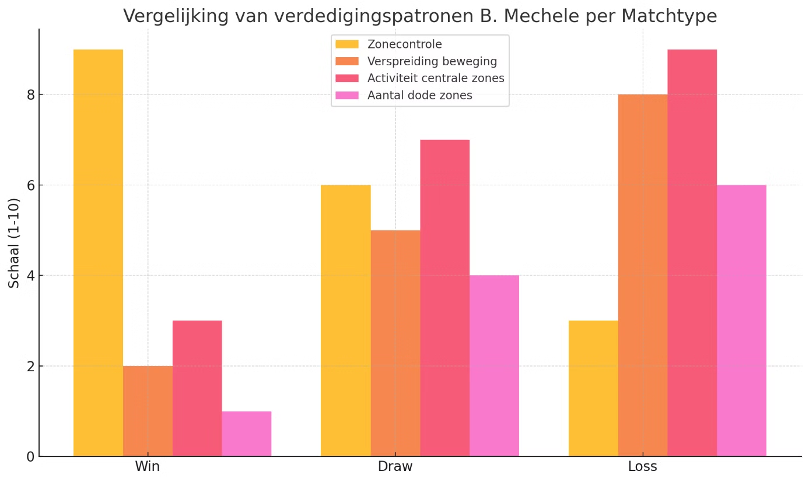
Comparative Defensive Metrics
Win
Draw
Loss
When comparing the defensive metrics across all three matches, a clear correlation emerges between positioning patterns and match outcomes. Zone control—the ability to maintain designated defensive responsibilities—shows the strongest relationship with positive results. In the winning match, Mechele's zone control reached a high score of 9, compared to just 3 in the loss. Conversely, movement spread (a measure of positional chaos) was highest in the defeat. The relationship between these metrics provides compelling evidence that disciplined positioning contributes significantly to defensive success and, ultimately, match results.

Slide 8
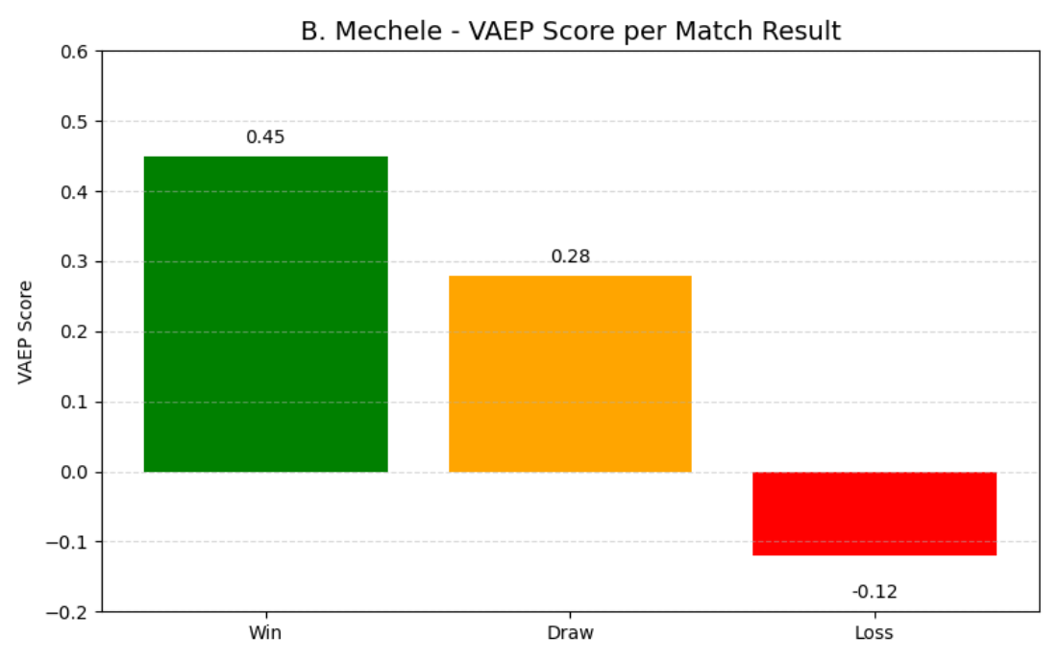
Vaep

Slide 9
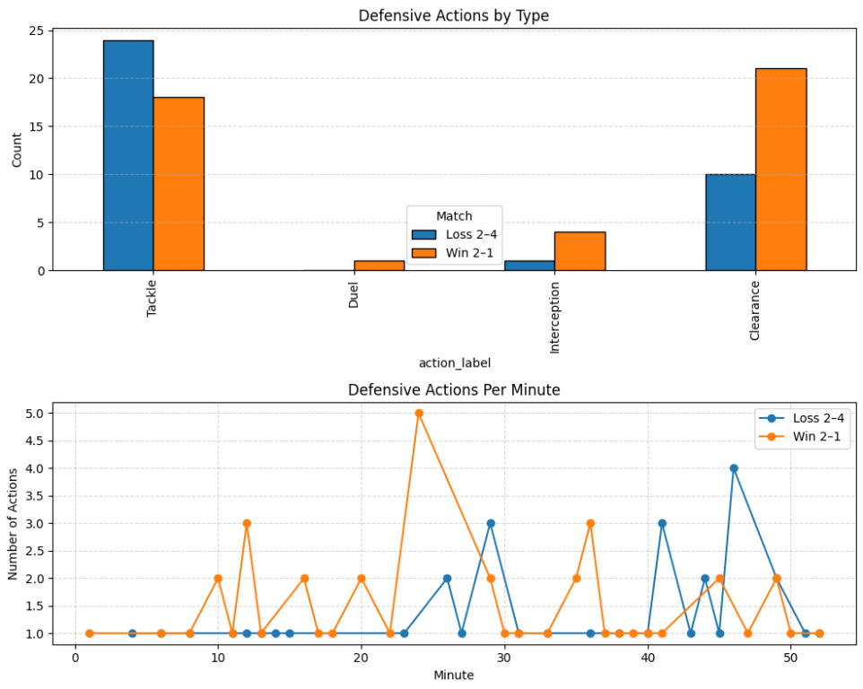
Defensive Actions

Slide 10
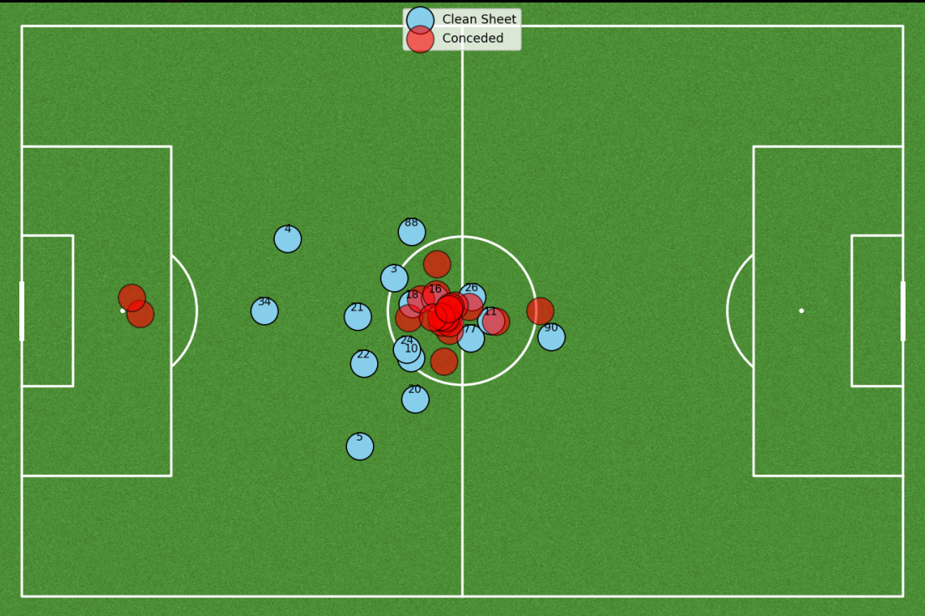
Average defensive shape

Slide 11








Tactical Implications for Defensive Structure
Match Success
→ Strong defensive structure leads to better results
Improved win probability
Defensive Stability
→ Clear zonal responsibilities prevent chaos and improve team resilience
Fewer chances conceded
Team Organisation
→ Positional discipline enhances coordination across the defensive unit
Better coordination and coverage
Positional Discipline
→ Central defenders, like Mechele, must prioritize maintaining shape over chasing immediate threats
Maintaining assigned zones

Slide 12
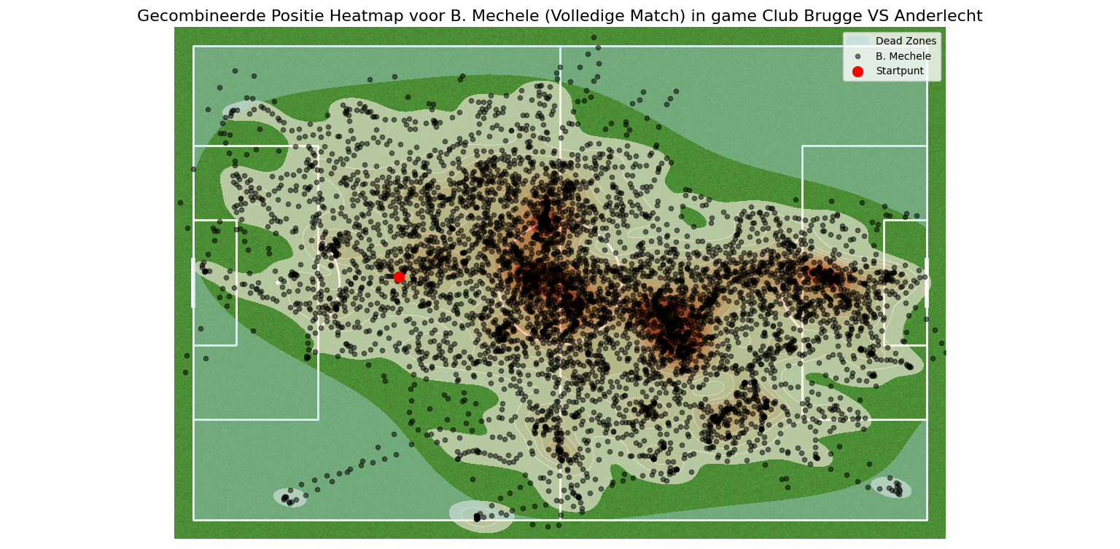
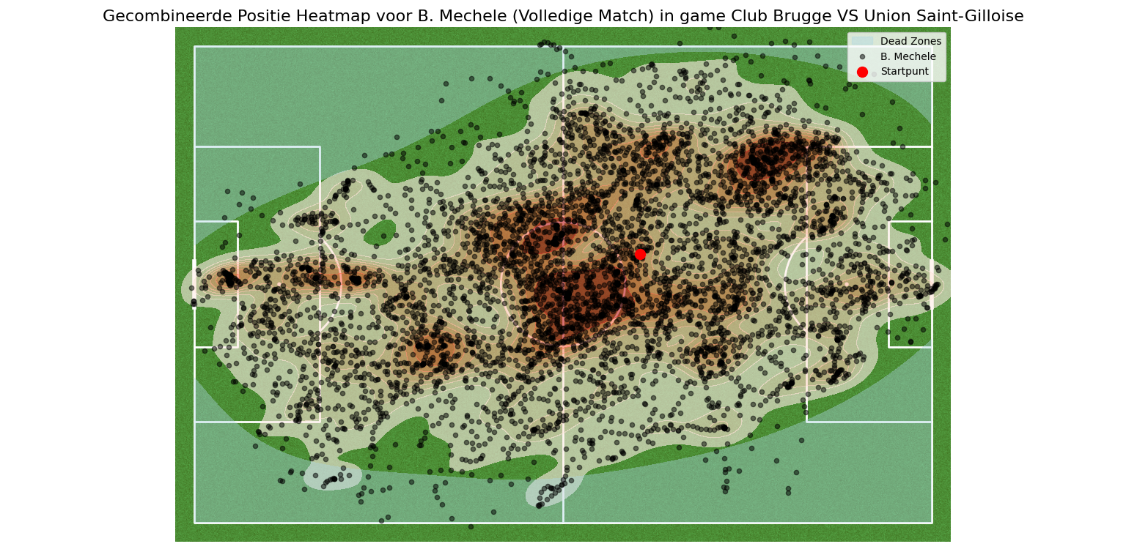
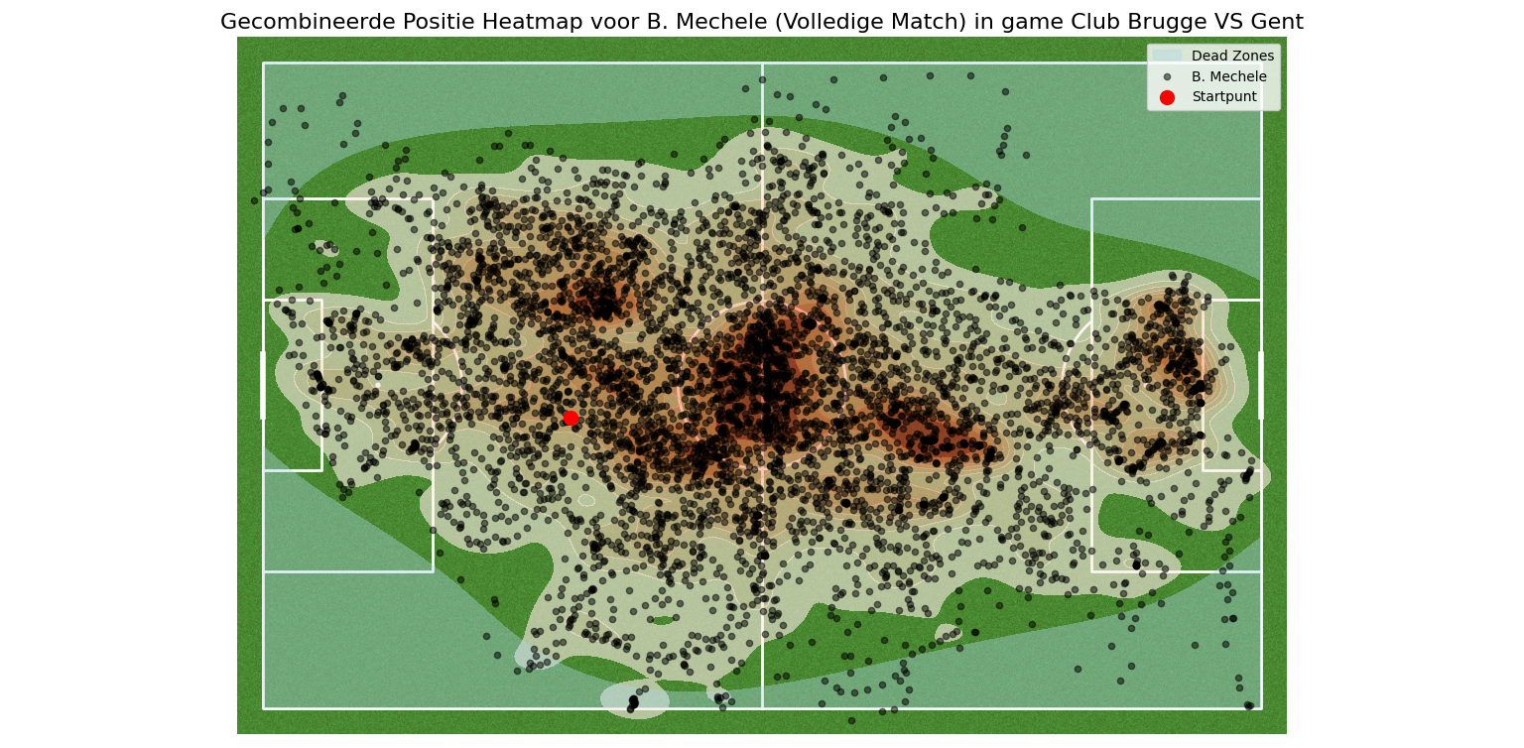
Positional Heat Maps Comparison
Winning Pattern
Drawing Pattern
Losing Pattern
Concentrated activity on right flank, minimal movement elsewhere, logical dead zones
Well-distributed activity, slightly more central presence, balanced approach
Scattered activity, dual hotspots, extensive movement into attacking areas

Slide 13
Training Applications: Enhancing Zonal Discipline
Video Analysis Sessions
Communication Protocols
Regular review of positioning patterns with feedback on both positive and negative examples
Defensive Shape Retention
Zonal Awareness Drills
Establishing clear verbal and non-verbal signals to coordinate defensive movements and handovers between zones
Training exercises that emphasize maintaining position within designated zones, with penalties for unnecessary movement
Scenarios that challenge defenders to maintain structure even when attackers attempt to pull them out of position

Slide 14




Contextual Factors and Adaptability
Opponent Tactical Approach
Match Situation
Defending against possession-based teams may require different positional strategies than counter-attacking sides
Score line and time remaining may necessitate adjusted positioning priorities
Teammate Positioning
Strategic Flexibility
Defensive movements should be coordinated with fellow defenders to maintain overall structure
Developing ability to shift between rigid zonal discipline and necessary adaptability

Slide 15
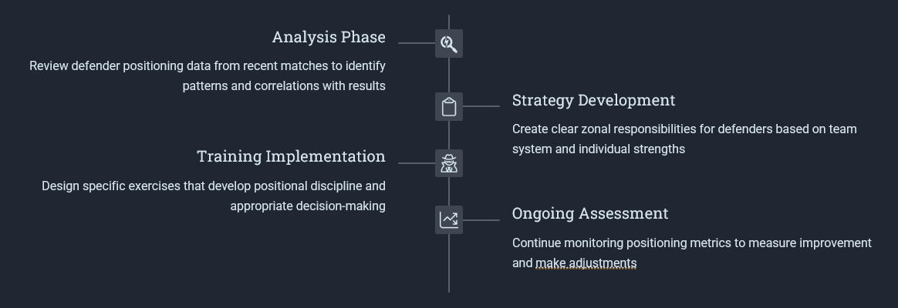
Key Takeaways and Implementation Strategy

